Slide 1
LIN6209 Coding for Linguists
The analysis of text
Probability & Statistics
APIs
sources of text and data

Slide 2
Last Week – Data Visualization
Line graphs
Bar charts
Histograms
Scatter plots
Pie charts
Contour maps
Pseudo-colour images
Some background on:
Panda
Numpy
Matplotlib
Seaborn
These packages have a large number of methods, often with an equally large number of options
So . . . Keep Things SIMPLE

Slide 3
design
build
test
evaluate
analyse
requirements

Slide 4
This week – analysing text
Randomness
Probability
Dependant & Independent events
Bayes Theorem
Statistical measures
Average: mean, mode, median
Distributions
Measures of variance
Regression Analysis
Cluster analysis

Slide 5
Randomness & Probability

Slide 6

Random events
Picking a marble out of a bag:
3 blue
9 red
Tossing a coin
Heads
Tails
Pick a card, any card, …

Slide 7
Dependant & Independent events

Slide 8
Choosing two marbles from a bag
Independent events
Dependent events
Choose a marble from the bag
Replace marble in bag
Choose a marble from the bag
Choose a marble from the bag
Do not replace marble in bag
Choose a marble from the bag

Slide 9
Python libraries
# standard library
# do these first
import random
randint(5)
choice() # read
Choices # the Python
shuffle() # docs
sample() # for these
# numpy library
# do these second
from numpy import random x=random.randint(100, size=(5)) print(x)
# W3schools numpy

Slide 10
Task 1
Task 2
from numpy import random as r x=r.randint(100, size=(25)) y=r.randint(100, size=(25))
# create scatter plot
# in a Jupyter notebook
# create a separate chart with # floating point random values
# create a third scatterplot # containing both sets of data.
# label the chart and axis. # colour the data meaningfully.

Slide 11
Assignment feedback

Slide 12
Bayes’ Theorem
The probability of event B given that event A has already happened

Slide 13
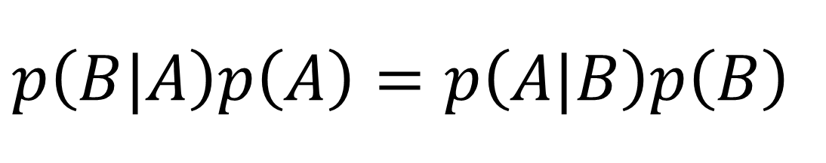
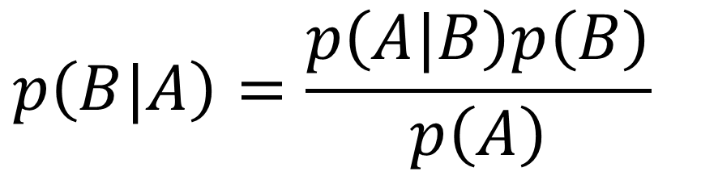
$$p\left(B|A\right)=\frac{p\left(A|B\right)p\left(B\right)}{p\left(A\right)}$$
A
B
A
A&B
B
$$p\left(B|A\right)p\left(A\right)=p\left(A|B\right)p\left(B\right)$$

Slide 14
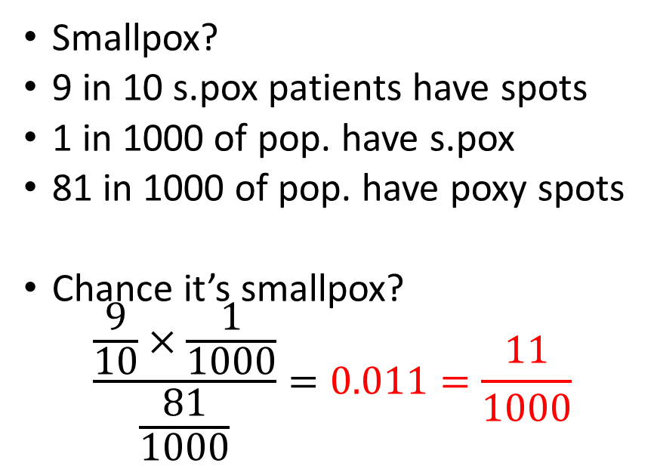
It’s the mid 18th century Chickenpox or smallpox?
The patient
The doctor
A sudden rash of blistery spots
Looks like smallpox !
Smallpox is often fatal !!!
I’m a gonner!
Smallpox?
9 in 10 s.pox patients have spots
1 in 1000 of pop. have s.pox
81 in 1000 of pop. have poxy spots
Chance it’s smallpox?
$$\frac{\frac{9}{10}×\frac{1}{1000}}{\frac{81}{1000}}=0.011=\frac{11}{1000}$$

Slide 15
Bayes Theorem for Machine Learning
Conditional probability
Muffled sound A after sound(s) B then most probably A is sound ‘X’
Unknown word after word(s) B is most probably the word ‘Y’
Classification analysis
Most likely it’s an ‘X’ rather than a ‘Y’
Example – analysis of Titanic survival probabilities*
Woman with 1st class ticket – group most likely to write memoirs
Anyone in 3rd class or stowage – put last message in a bottle now
* Titanic step-by-step analysis on Kaggle: https://www.kaggle.com/alexisbcook/titanic-tutorial

Slide 16
Statistical Measures
Bringing it all down to one number

Slide 17
Statistical Measures
Mean
Arithmetic, Harmonic
Mode
Most frequent data item
Median
Equal data both sides
Variance
Standard deviation
Skew
Distribution
Binomial
Normal
Log normal
…

Slide 18
Python statistics Library
https://docs.python.org/3/library/statistics.html
https://www.w3schools.com/python/module_statistics.asp
Use statistics judiciously
Case by case – decide which statistical measures give meaningful insights into the structure of your data

Slide 19
Regression Analysis
‘Best fit’ approximations

Slide 20

Linear Regression Prediction with a straight edge ruler
good fit
poor fit
→
y
$$y=mx+c$$
x→

Slide 21
Linear Regression
Good Fit – least total error
good fit
Square of distance between datapoints and prediction

Slide 22
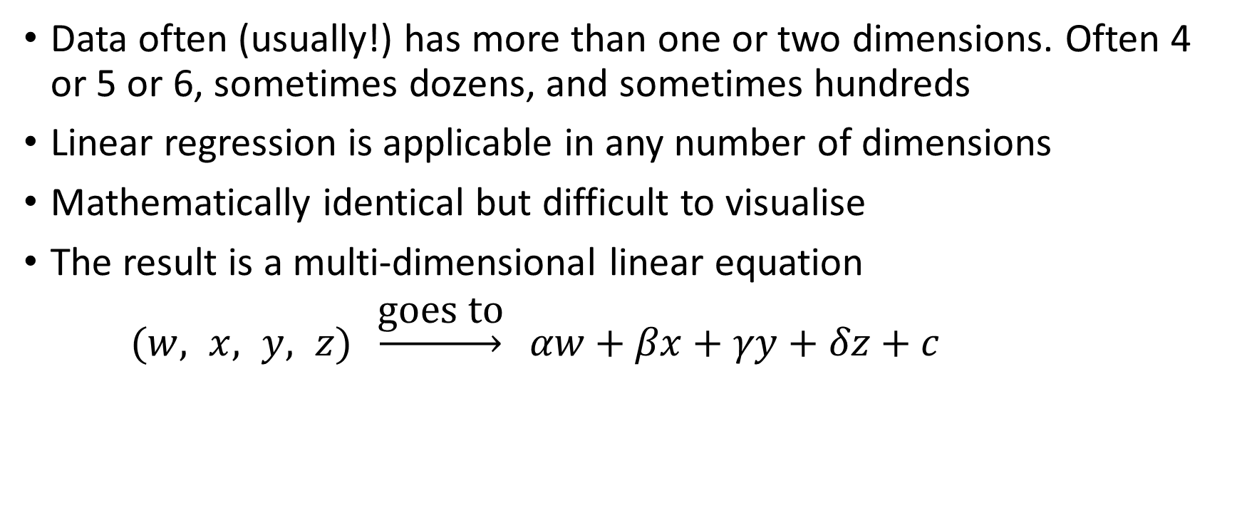
Multidimensional Linear Regression
Data often (usually!) has more than one or two dimensions. Often 4 or 5 or 6, sometimes dozens, and sometimes hundreds
Linear regression is applicable in any number of dimensions
Mathematically identical but difficult to visualise
The result is a multi-dimensional linear equation
$(w, x, y, z) \underset{→}{\text{goes} \text{to}} αw+βx+γy+δz+c$

Slide 23
Polynomial Regression – the data

Slide 24
Polynomial Regression – good enough?

Slide 25
Polynomial Regression – is middle bump real?

Slide 26
Polynomial Regression – overfitted

Slide 27
Regression with Anaconda (python 3.8)

Slide 28
Anaconda (3.8) regression analysis
# import libraries
import numpy as np
import matplotlib.pyplot as plt
from sklearn.linear_model import LinearRegression

Slide 29
Anaconda (3.8) – prepare the data
# get the data
xdata = np.array([5, 15, 25, 35, 45, 55])
ydata = np.array([5, 20, 14, 32, 22, 38])
# transform arrays for regression
x = xdata.reshape((-1, 1))
y = ydata
# print these to check they are OK and see the shape

Slide 30
Anaconda (3.8) – create model and fit to data
# create model object
model = LinearRegression()
model.fit(x, y)
# examine its properties
r_sq = model.score(x, y)
print('coefficient of determination:', r_sq)
print('intercept:', model.intercept_)
print('slope:', model.coef_)

Slide 31
Anaconda (3.8) – plot the data and regression
plt.plot(xdata, ydata, ls='', marker = 'o’)
yline = np.array([model.intercept_, 55*model.coef_[0] + model.intercept_])
xline = np.array([0, 55])
plt.plot(xline, yline)
plt.show()

Slide 32
Anaconda (3.8) another example
xdata2 = np.array([0.1, 1.09, 2.11, 2.91, 3.8, 4.9, 5.9])
ydata2 = np.array([1.9, 4.9, 8.2, 11.4, 13.7, 16.7, 20.2])
plt.plot(xdata2, ydata2, ls='', marker = 'o’)
x2 = xdata2.reshape((-1, 1))
y2 = ydata2
model2 = LinearRegression().fit(x2, y2)
yline2 = np.array([model2.intercept_, 6*model2.coef_[0] + model2.intercept_])
xline2 = np.array([0, 6])
plt.plot(xline2, yline2)
plt.show()

Slide 33
Python 3.10
New feature in Python 3.10

Slide 34
Python – regression analysis
# python version 3.10 includes # linear_regression() in statistics library
xdata = [0.1, 1.09, 2.11, 2.91, 3.8. 4.9, 5.9]
ydata = [1.9. 4.9, 8.2,11.4, 13.7, 16.7, 20.2]
# plot data and best fit linear model # on same chart

Slide 35
Python – installed on your PC
Upgrade to version 3.10
Error messages much improved!
IDLE has minor but worthwhile improvements

Slide 36
Category Analysis

Slide 37

Friend or Foe?

Slide 38
Pattern Analysis
There are a multitude of patterns that do not yield to regression

Slide 39


Other techniques required

Slide 40
Change of Topic APIs and the request library

Slide 41
APIs
Application Programming Interfaces

Slide 42
Application Programming Interfaces
The way applications ‘talk’ to each other
Application objects make calls on each others interface methods
These are much like function calls
Each interface method publishes a contract
A method contract guarantees that if the caller supplies parameters that satisfy the methods published pre-conditions, then the method will respond according to its specification
Authentication is immensely important

Slide 43
Application
1
Application
2
interface
interface
a
x
b
c
y
d
e
z
f
request or response
request or response

Slide 44
The requests library
Making application calls across the internet.
This is a complex topic so this is just the briefest of introductions

Slide 45
import requests
response = requests.get("https://randomuser.me/api/")
response # if this is code 200 then call was successful
response.text # lets see the details
# and another API “the dog api” ☺
response = requests.get("https://api.thedogapi.com/")
response.text
response = requests.get("https://api.thedogapi.com/v1/breeds")
response.text[:500]

Slide 46
Collections / Directories of APIs
GitHub Public APIs repository
https://github.com/public-apis/public-apis
Public APIs
https://public-apis.io/
Public API
https://public-apis.xyz/
Any API
https://any-api.com/

Slide 47
Next week Regular Expressions
https://docs.python.org/3/library/re.html

